Slide 1
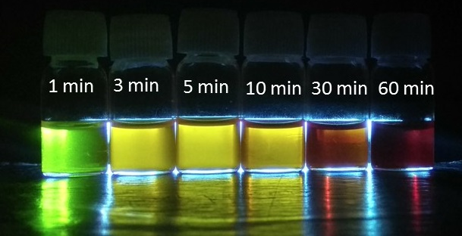
Particle in a box

Slide 2
Born Interretation: Restrictions on wavefunction
ψ must be a solution of the Schrodinger equation
ψ must be normalizable: ψ must be finite and 0 at boundaries/ ±∞
Ψ must be a continuous function of x,y,z
dΨ/dq must be must be continuous in q
Ψ must be single-valued
Ψ must be quadratically-intergrable
(square of the wavefunction should be integrable)
Origin of quantization

Slide 3
Quantum Mechanics
Examples of Exactly Solvable Systems
Free Particle
Particle in a Square-Well Potential (Particle in a box)
Hydrogen Atom

Slide 4
Free Particle
Time-independent Schrodinger equation
For a free particle V(x)=0
There are no external forces acting

Slide 5
Free Particle
Second-order linear differential equation
Let us assume
Trial Solution

Slide 6
Free Particle

Slide 7
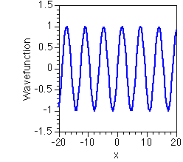
Free Particle
de Broglie wave
There are no restrictions on k
E can have any value
Energies of free particles are continuous
No Quantization All energies are allowed
Is this a good wavefunction?

Slide 8
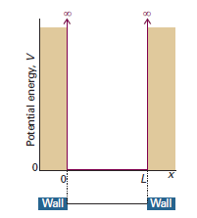
Particle in 1-D Box
For x < 0 and x > L ⇒ V = ∞
For 0 ≤ x ≤ L ⇒ V = 0
Zero
Trial Solution:
Energy:
Wavefunction should be continuous:
Boundary condition

Slide 9
Particle in 1-D Box
n = 1, 2, 3, 4, …..
n ≠ 0, as wavefunction cannot be zero everywhere
For x < 0 and x > L ⇒ V = ∞
For 0 ≤ x ≤ L ⇒ V = 0
Trial Solution:
Energy:
Boundary condition

Slide 10
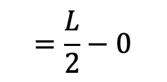
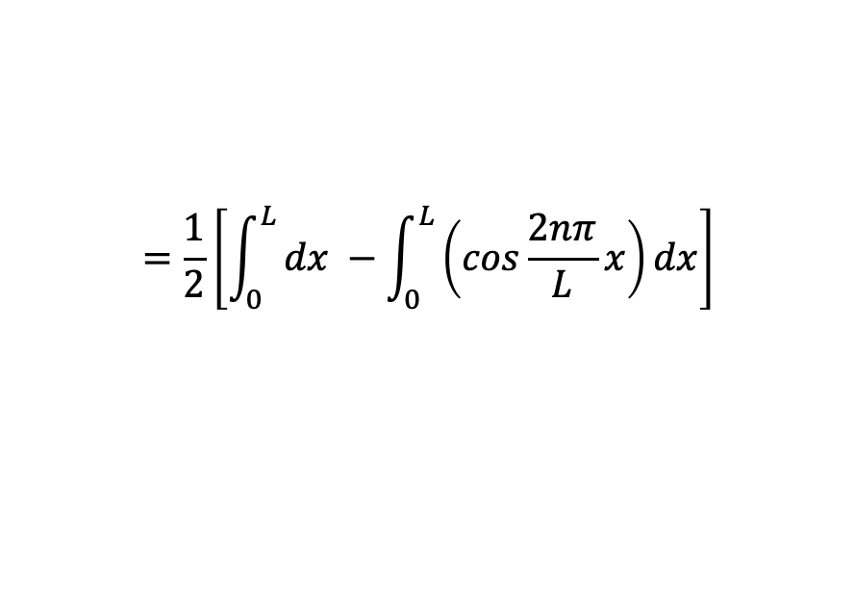
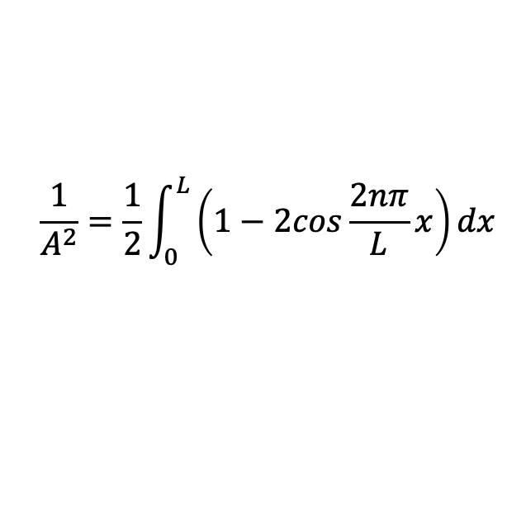
Particle in 1-D Box: Normalization
n = 1, 2, 3, 4, …..
n ≠ 0, as wavefunction cannot be zero everywhere
$$\frac{1}{A^{2}}=\frac{1}{2}\int_{0}^{L}{\left(1−2cos\frac{2nπ}{L}x\right)dx}$$
$$=\frac{1}{2}\left[\int_{0}^{L}{dx −\int_{0}^{L}{\left(cos\frac{2nπ}{L}x\right)}dx}\right]$$
$$=\frac{L}{2}−0$$

Slide 11
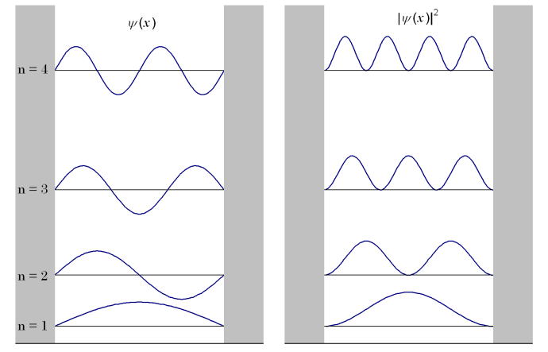
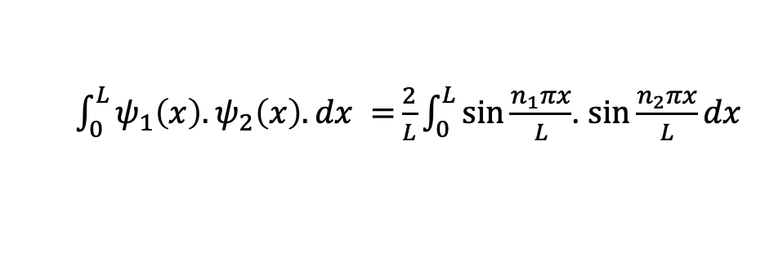
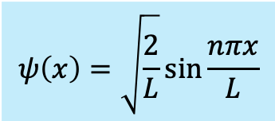

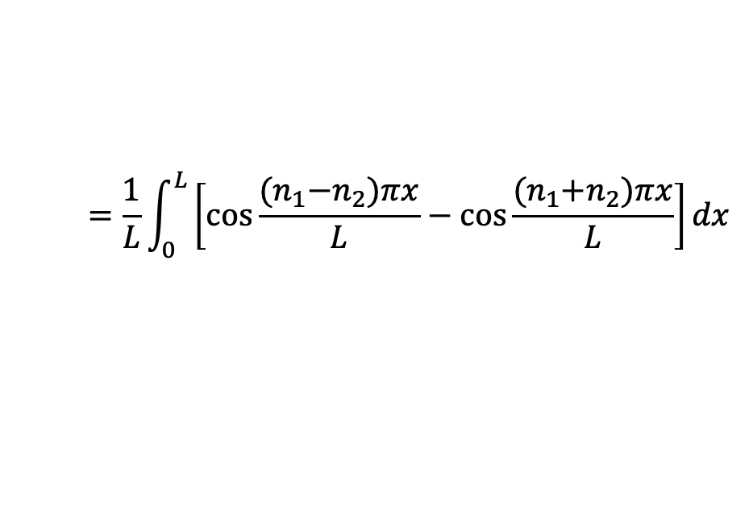
Particle in 1-D Box: Wavefunctiona
$$ψ\left(x\right)=\sqrt{\frac{2}{L}}\sin{\frac{nπx}{L}}$$
n = 1, 2, 3, 4, …..
n ≠ 0, as wavefunction cannot be zero everywhere
Orthogonality
$\int_{0}^{L}{ψ_{1}\left(x\right).ψ_{2}\left(x\right).dx =}\frac{2}{L}\int_{0}^{L}{\sin{\frac{n_{1}πx}{L}}}$. $\sin{\frac{n_{2}πx}{L}dx}$
$$=\frac{1}{L}\int_{0}^{L}{\left[\cos{\frac{{(n}_{1}−n_{2})πx}{L}}−\cos{\frac{{(n}_{1}+n_{2})πx}{L}}\right]dx}$$
$$=0$$
Is the first derivative continuous?
Not at x = 0 and x = L

Slide 12
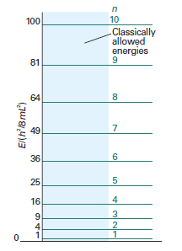
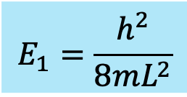
Particle in 1-D Box: Energy
$$ψ\left(x\right)=\sqrt{\frac{2}{L}}\sin{\frac{nπx}{L}}$$
n = 1, 2, 3, 4, …..
n ≠ 0, as wavefunction cannot be zero everywhere
Energy is quantized!
Boundary conditions are the origin of quantization
Energy separation increases with increasing values of n
Lowest possible energy is non-zero: Zero point energy
$$E_{1}=\frac{h^{2}}{8mL^{2}}$$
Larger the box, smaller the energy of hν

Slide 13


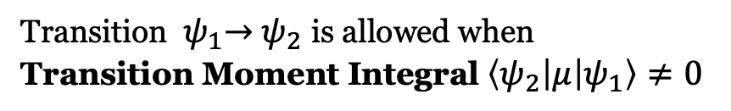

Particle in 1-D Box: Spectroscopy
Wavefunction:
n=1,3.. Symmetric wrt inversion (even function)
n=2,4.. Anti-Symmetric (odd function)
Number of Nodes (zero crossings) = n-1
Transition ${ ψ}_{1}→{ ψ}_{2}$ is allowed when
Transition Moment Integral $\left\langle ψ_{2} | μ | ψ_{1}\right\rangle ≠0$
$$\left\langle ψ_{2} | x | ψ_{1}\right\rangle ≠0$$
$$μ=e.x$$
Non-zero integral: Symmetric integrand
Antisymmetric
If one wave function is symmetric, then the other should be antisymmetric
Selection rule: $Δn=1, 3, 5, …..$
Odd to even, even to odd transitions are allowed

Slide 14
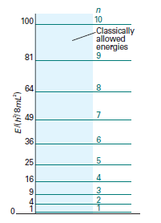
Particle in 1-D Box: Examples in Chemistry
$$ψ\left(x\right)=\sqrt{\frac{2}{L}}\sin{\frac{nπx}{L}}$$
n = 1, 2, 3, 4, …..
Hexatriene: a linear molecule of length 7.3 Å
It absorbs at 258 nm
Use particle in a box model to explain the results.
Compare with the experimental value of 258 nm
Particle in a box is a good first approximation



Six π electrons fill lower three levels

Slide 15
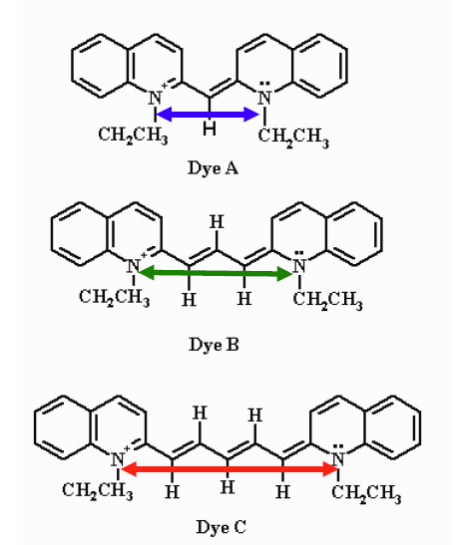
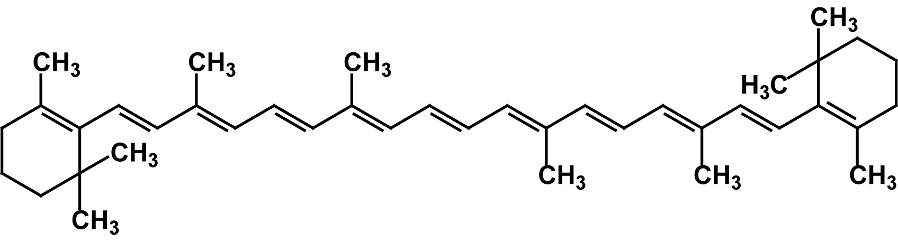
Particle in 1-D Box: Examples in Chemistry
Electronic spectra of conjugated molecules
$$ψ\left(x\right)=\sqrt{\frac{2}{L}}\sin{\frac{nπx}{L}}$$
n = 1, 2, 3, 4, …..
Increase in bridge length increase the emission wavelength.
Predicts correct trend and gets the wavelength almost right.
Particle in a box is a good first approximation
Β-carotene is orange because of 11 conjugated double bonds

Slide 16
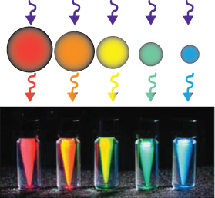
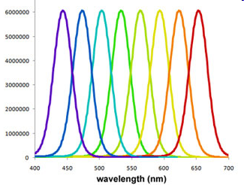
Particle in 1-D Box: Examples in Chemistry
$$ψ\left(x\right)=\sqrt{\frac{2}{L}}\sin{\frac{nπx}{L}}$$
n = 1, 2, 3, 4, …..
Quantum Dots – Quasi-particle (exciton) in a Box!
CB
CB
CB
VB
VB
VB

Slide 17
Expectation value: Position

Slide 18
Expectation value: Position
Probability in a thin strip for different n and x values

Slide 19
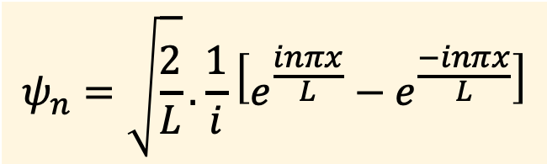
Expectation value: Momentum
Eigenfunctions:
Equal magnitude,
opposite direction
$$ψ_{n}=\sqrt{\frac{2}{L}}.\frac{1}{i}\left[e^{\frac{inπx}{L}}−e^{\frac{−inπx}{L}}\right]$$
Equal probability for propagation
in the two directions

Slide 20


Particle in a 2-D box
Separation of variables
V=0
L_{y}
L_{x}
Square Box
⇒ L_{x} = L_{y} = L

Slide 21

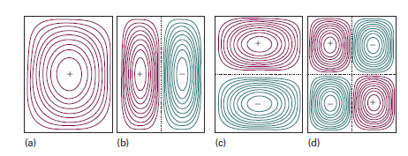
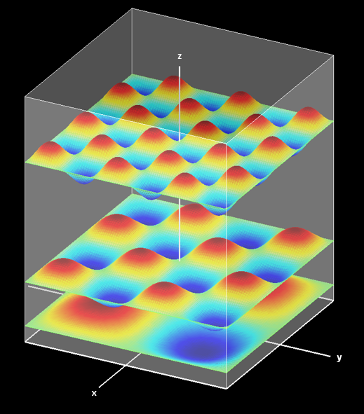

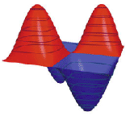
Particle in a 2-D box: Wavefuntiona
Number of nodes = n_{x}+n_{y}-2

Slide 22
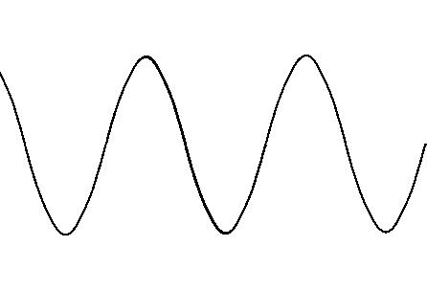
Rectangular box
V=0
L_{y}
L_{x}
(1, 2) and (2, 1) levels, for example,
have same energy in square box, but not in rectangular box
Symmetry and degeneracy go hand in hand

Slide 23
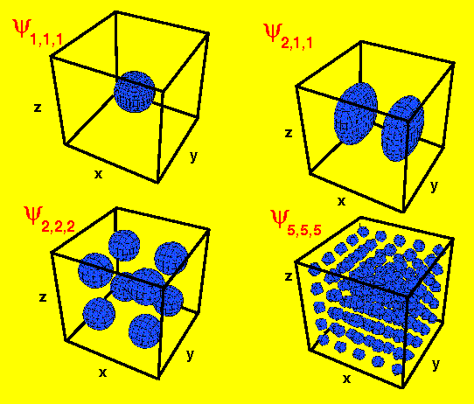
3D box

Slide 24
Particle in a box: Take home messages
Schrodinger equation is exactly solvable
Boundary conditions: Quantization
More nodes in wavefunction, higher is the associated energy
Eigenfunction of linear momentum operator
Simple model, finds application in Chemistry
Increase in dimensionality: Separation of variable
Symmetry and degeneracy go hand in hand
Beyond 3D functions
Testing ground for more sophisticated treatment
What happens if the potential barrier is finite?

